Slide 1
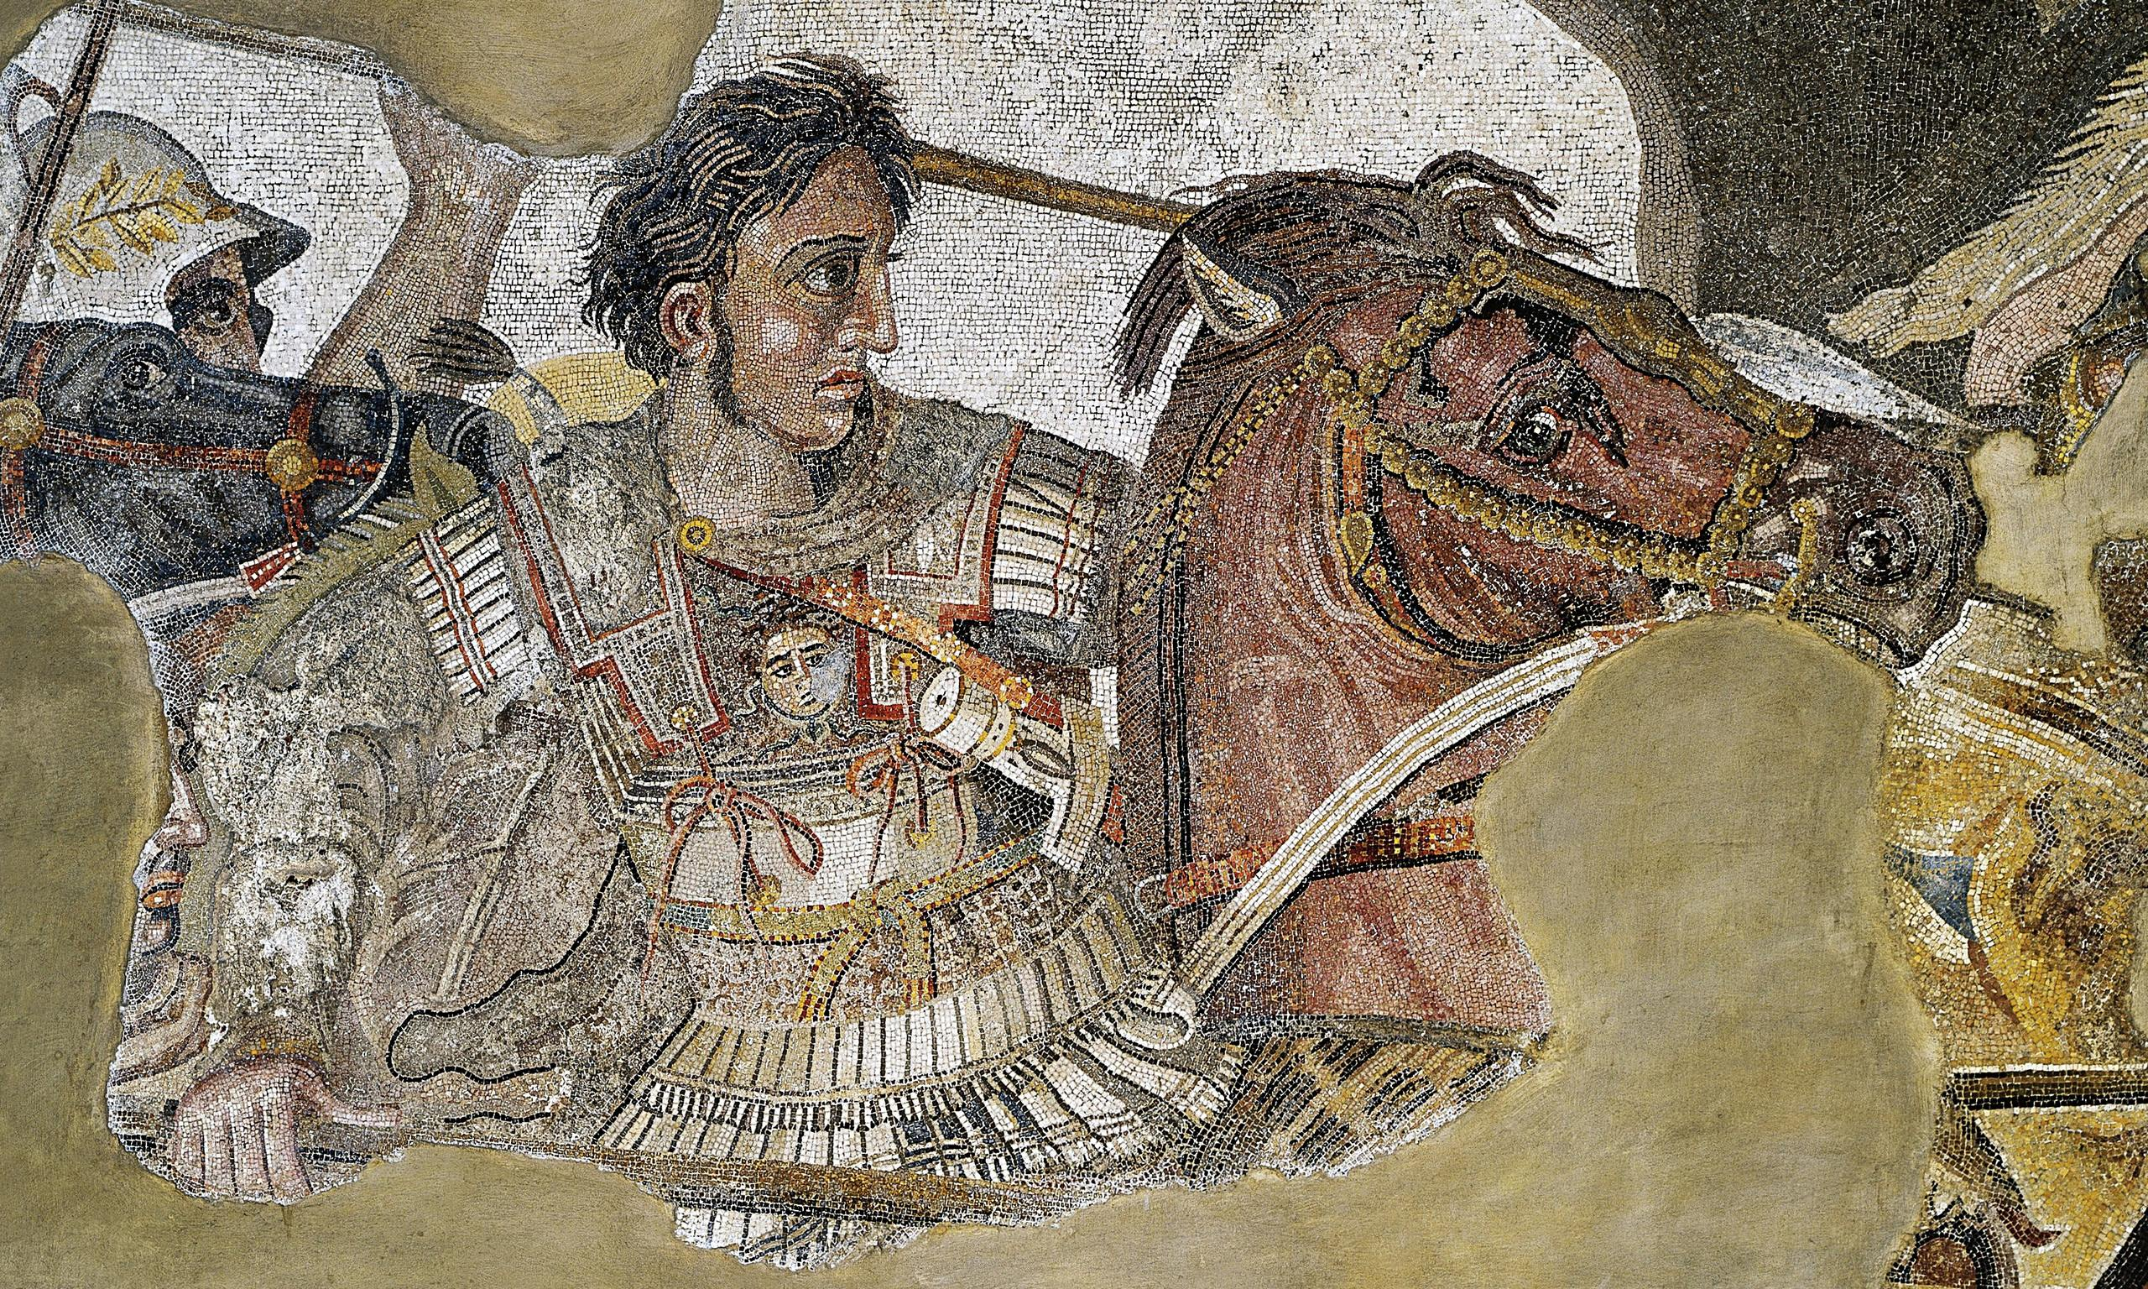
Issus and Egypt
Goal/s:
identify the events of the battle of issus
Week 9 Lesson 4 – unit 2
Ms Barrie

Slide 2
On the 5th of November 333 BCE, Alexander the Great and his army met the Persian forces of Darius III in Battle at Issus. The clash between these two great armies would be one of the most decisive in history.

Slide 3
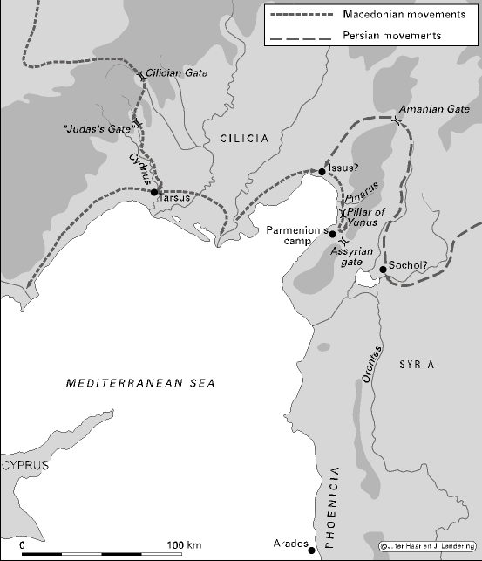
Map of the Issus Campaign

Slide 4
ACTIVITY - Documentary
https://www.youtube.com/watch?v=pEsyRHLmBGw&ab_channel=KingsandGenerals
Watch the following documentary about the Battle of Issus
Take DOT-POINT notes in your book
Be prepared to discuss the following question:
Why did Alexander win the Battle of Issus?

Slide 5

Aftermath
The Persian defeat was so total, and they had fled from the battlefield in such a hurry that they left behind their camp and all their supplies.
This was a clear victory for Alexander and his army. Not only had he decisively defeated the largest army in the world, but he had also captured Darius' family, including his wife, children, and mother.
However, Darius asked for the return of his family, promising Alexander half of his kingdom, which was rejected. Instead, Alexander challenged him to face him again on the battlefield.

Slide 6
Alexander in Egypt
After Alexander's victory at Issus, he marched south to Persian-controlled Egypt. Alexander wanted Egypt because he knew that it was a wealthy nation and he wanted to add its resources to his empire. He conquered Egypt in 332 BC.
The Egyptians were happy to see Alexander, since they had been oppressed by the Persians for many years. They welcomed him as a liberator and gave him gifts of gold and silver.
In return, Alexander made Egypt a part of his empire and named the city of Alexandria after himself. He also placed Egyptians in high positions within his government and allowed them to keep their religion and customs.

Slide 7
Alexander visits Siwa
While in Egypt, Alexander visited the Temple of Amun-Ra at Siwa Oasis. The temple was home to the Oracle of Amun-Ra, who was said to be able to answer any question.
When Alexander asked the Oracle if he was indeed the son of Zeus, the Oracle replied that he was indeed a god and not a mortal man.
This response pleased Alexander and solidified his belief that he was destined to conquer the world.
After his visit to the Temple of Amun-Ra, he returned to Memphis, where he held a cultural and sports festival for both Egyptians and Greeks. He wanted this to be an example of cooperation between the two ancient civilisations.
After six months in Egypt, Alexander left to chase Darius once more in 331 BC. Alexander would not see Egypt again. Only after his death would his body return to the city he named after himself, to be buried.

Slide 8
ACTIVITY – Write a paragraph
Why was the Battle of Issus one of Alexander’s most important victories during his campaign against Darius III and the Persian Empire?
Think about: Macedonian morale/recruitment

